Slide 1
Single Sign On
Citi and Cartus in partnership are introducing a new way to
access Cartus Online from the ‘Citi For You’ intranet.
Single Sign On will enable the user to click on the Cartus Online
link which will take the user into the Cartus Online site using
their SSO user name password for added convenience.

Slide 2


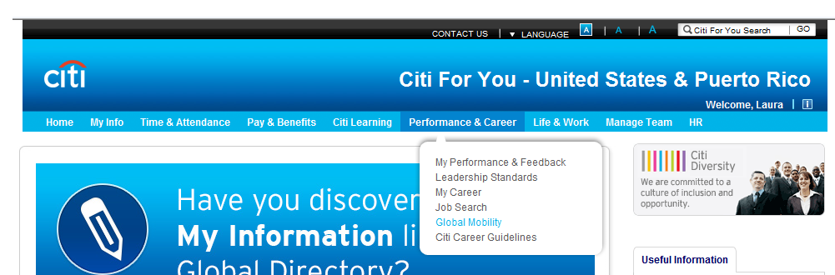
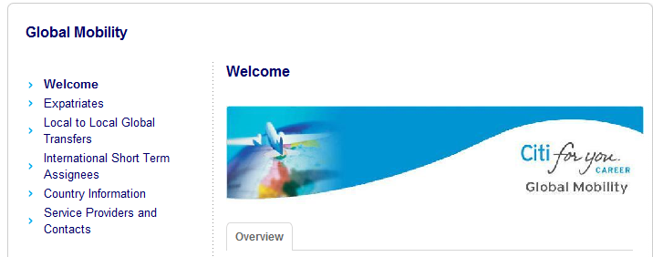
Customer View
You can access CartusOnline by visiting the Global Mobility Citi For You site at:
Citi For You – Performance & Career – Global Mobility – Service Providers & Contacts
and clicking on the “Cartus Online” hyperlink
http://www.citigroup.net/citiforyou/landingpage?objId=0901d11f80337314&objType=T&lang=105
Section 1
To access CartusOnline:
First, click the “Performance & Career” tab and then select “Global Mobility” from the dropdown list
Next, click “Service Providers and Contacts”

Slide 3
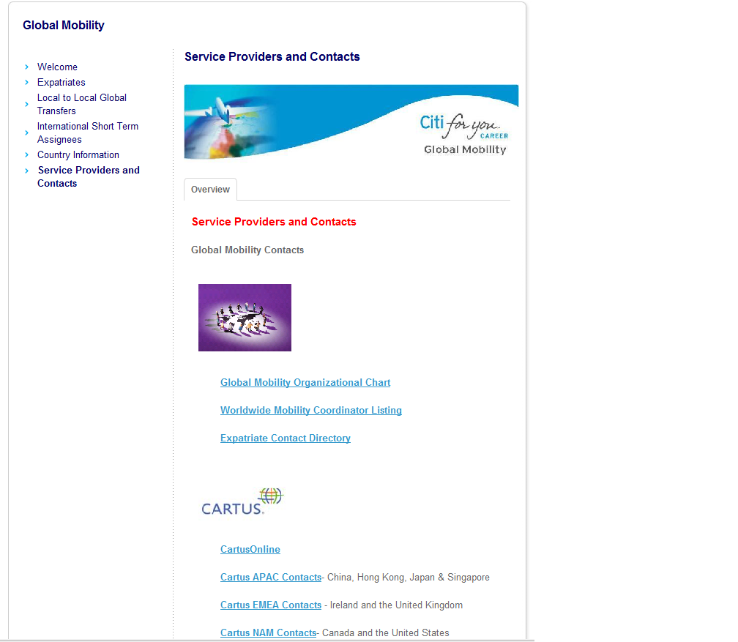
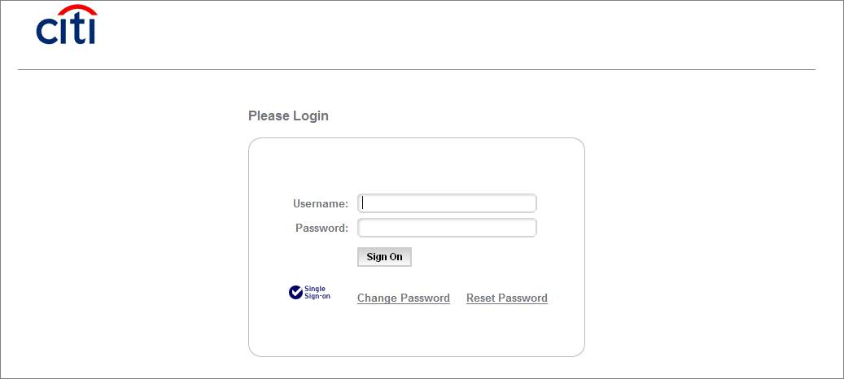
Customer View
Lastly, click the “CartusOnline” link and simply enter your Citi SSO Username and Password in the pop-up window.

Slide 4
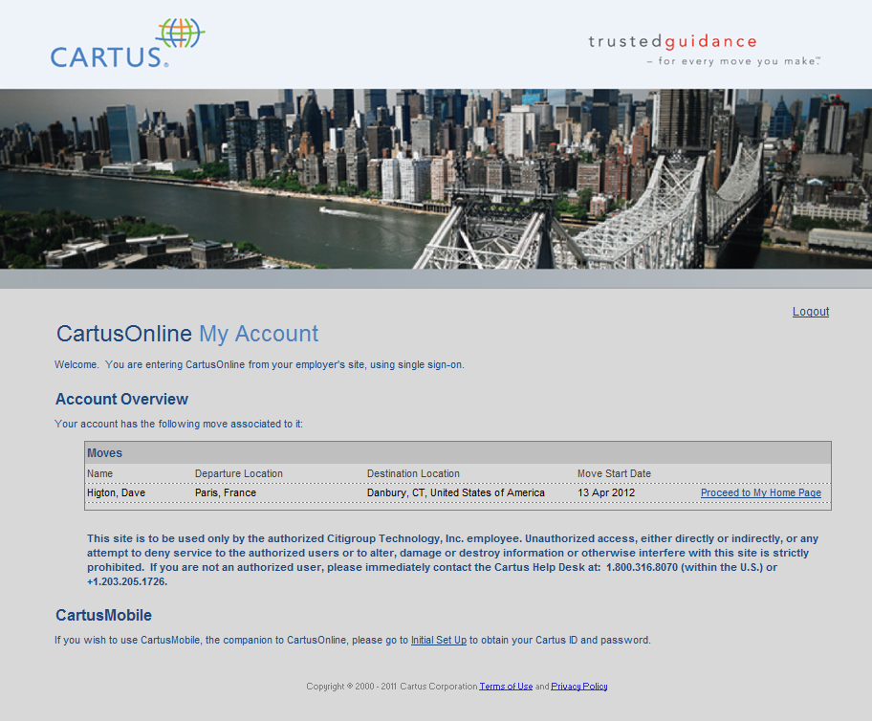
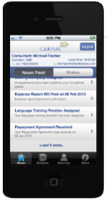
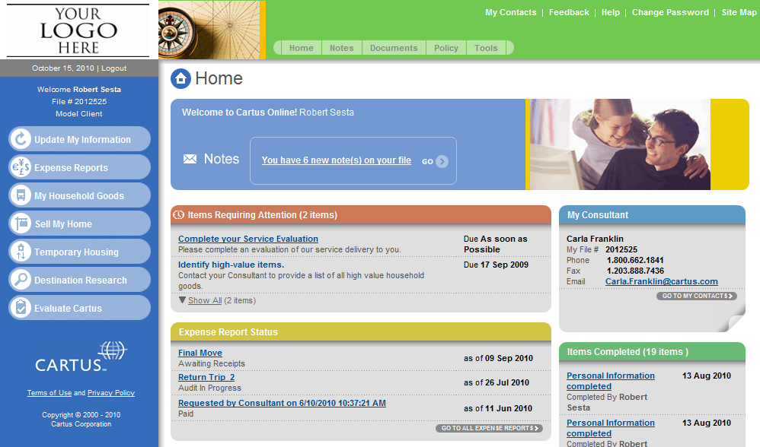

Customer View
The “CartusOnline” hyperlink will launch you to a new page that provides you instant access to all of your active assignments without the need for a separate UserID & password.
Section 2
Section 3
Mobile App requires a new UserID & Password
1) Click on “Initial Set-up” link
2) A UserID will be generated for you
3) Create a Password
4) “Back to My Account” link will bring you back to your CartusOnline page.

